Slide 1
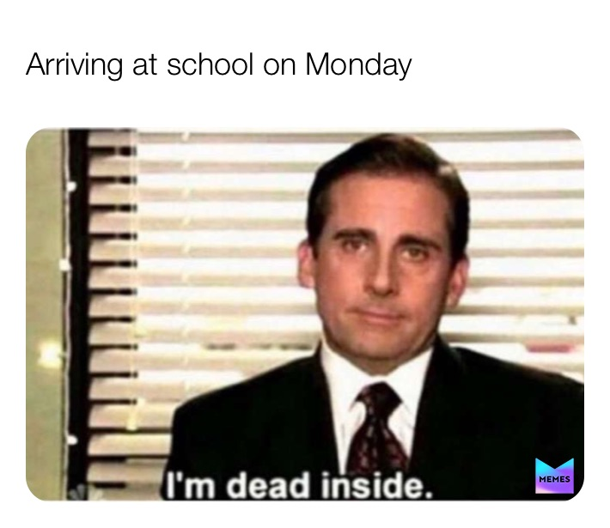
Happy Monday!!!

Slide 2




Problem & Intro to Project
Notes:
Did anyone have any trouble with the quiz?
How do you feel about the first quiz? Hard, easy? Time wise?
I saw that a lot of you only took the test once, hence I just want to remind that you can take the quiz twice and only the higher will be taken as your final score.

Slide 3

Lockdown Browser
Open Lockdown Browser
Log in Canvas
Proceed to take quizzes or exams
Computer Lab
Lockdown Browser 2 Lab
This Photo by Unknown Author is licensed under CC BY
Notes:
It’s a browser, so don’t use Google Chrome, Safari, or Firefox.
In case you don’t have Lockdown browser on your computer, or if your computer acts up, the computer lab on the basement also has Lockdown Browser, but it’s called Lockdown Browser 2 Lab.
You can just go there and take your quizzes and exams when there isn’t research being conducted.
This is why I strongly recommend you to take the quiz early in case you have problem. Sometimes, I can’t answer your email right away, so keep that in mind.

Slide 4

iClicker Question
How was the first test?
Extremely hard
Hard
I can handle it
Easy
Extremely easy

Slide 5
Recap
Problems: Are situations calling for managers to make choices among alternatives
Managerial objective: What the client hopes will result from the project to help them make decisions
Research objective: What information will help the client to achieve managerial objectives
Research questions: Questions that managers want to have answers
Notes:
I want to emphasize that there is a difference between managerial objective and research objective.
One managerial objective can translate into multiple research objective and then research questions.

Slide 6
iClicker Question
Methods of Ethical Reasoning are
Utility Approach
Justice Approach
Rights Approach
A and C
A, B and C

Slide 7

iClicker Question
We saw the Spread of Disease model last time.
What is the conclusion we can draw from the model?
The fewer people there are in a population, the faster it is for a disease to reach everyone.
The fewer people there are in a population, the slower it is for a disease to reach everyone.
Notes:
This is a bonus question

Slide 8
Agenda
Describe the basic uses of exploratory research
Specify the key characteristics of exploratory research. Small scale and very flexible studies are used to generate ideas and insights
Discuss the various types of exploratory research and describe each
Identify the key person in a focus group
Discuss two major pitfalls to avoid with focus groups (or any other form of exploratory research)
Notes:
Today’s agenda will be to describe exploratory research and its various types.

Slide 9
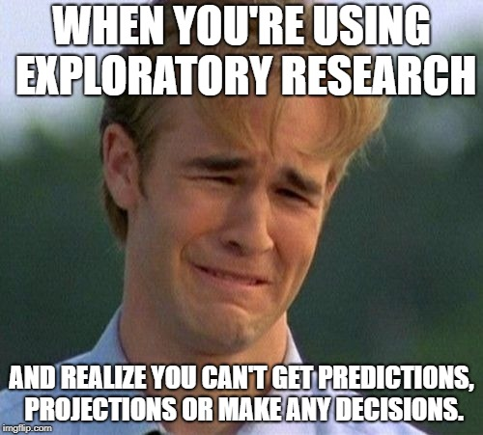
Exploratory Research
Research conducted to gain ideas and insights to better define the problem or opportunity confronting a manager
When conducted correctly, exploratory research should provide a better understanding of the situation and possibly yield hypotheses – but this kind of research is not designed to come up with final answers and decisions
Small scale
Flexible
Notes:
Can anyone tell me what exploratory research is?
And why do we usually want to do exploratory research before conducting our main research?
Please keep the exploratory research definition in mind. We will come back to it later.

Slide 10
Hypothesis
A statement that specifies how two or more measurable variables are related
Examples:
H1: Women are more likely than men to make impulse purchases of our brand
H2: Decreasing price by 10% will increase unit sales by 30%
H3: Adoption of our new product will be greater in Northern states than in Southern States
Notes:
So what is a hypothesis? Can anyone tell me?
Hypothesis: A statement that specifies how two or more measurable variables are related
The statement should be testable
H1: women are more likely than men to make impulse purchases of our brand
H2: Decreasing price by 10% will increase unit sales by 30%
H3: Adoption of our new product will be greater than Northern states than in Southern states
Identify variables:
H1: Gender and impulse purchases
H2: Price and sales
H3: Location and adoption of the new product

Slide 11
iClicker Question
Which ones are hypotheses?
Mizzou campus is beautiful
Mizzou students are more likely to graduate than any other college
Mizzou staffs are friendly
All of the above
Notes:
Identify the variables:
Demographic or students’ characteristics relates to graduation rate.
And this is again a hypothesis to be tested. I don’t know if it’s true or not

Slide 12
Why conduct exploratory research?
Develop hypotheses
Better formulate the manager’s decision problem
Increase researcher’s familiarity with the problem
Clarify concepts
Notes:
Again, why do we conduct exploratory research?
Can you tell me from the definition.
Why conduct exploratory research?
Develop hypotheses
Better formulate the manager’s decision problem
Increase researcher’s familiarity with the problem
Clarify concepts

Slide 13
Exploratory Research Types
Literature Search
Depth Interviews
Focus Groups
Data Mining
Case Analyses
Projective Methods
Notes:
These are types of exploratory research we typically in marketing. I bet that you have heard some of them before

Slide 14
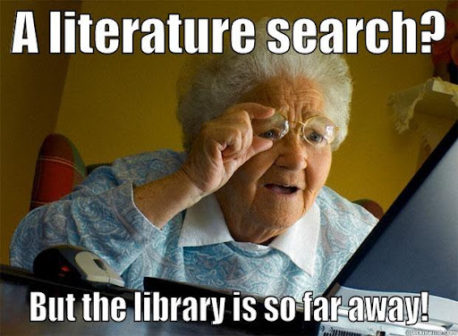
Literature search
A search of statistics, trade journal articles, other articles, magazines, newspapers, books, and/or online sources for data or insight into the problem at hand.
Notes:
What do you do when I say to conduct a literature search?
Literature Search: A search of statistics, trade journal articles, other articles, magazines, newspapers, books, and or online sources for data or insight into the problem at hand

Slide 15
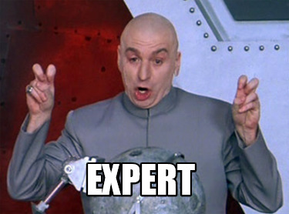
Depth Interviews
Interviews with people knowledgeable about the general subject being investigated
Some possibilities:
Those who work with it (e.g., employees, consultants)
Those who study (e.g., researchers, analysts)
Those who live it (e.g., consumers)
Notes:
In-depth interviews are typically with experts in the fields, or who are knowledgeable or familiar with the matter at hand.

Slide 16


Focus Group -SNL
Notes:
Has anybody heard of focus group before?
Can you define it?
If we have time in class, I will show it later. But you can always come back and watch it.

Slide 17
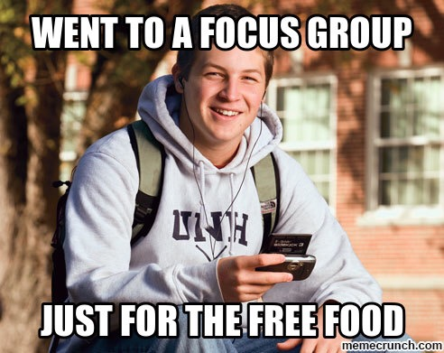
Focus Group
An interview conduct among a small number of individuals small number of individuals simultaneously; the interview relies more on group discussion than on directed questions to generate data
Notes:
Focus group is a special type of interview conducted among a small group of people that is typically directed by a moderator
Focus groups are small groups of people brought together and guided by a moderator through an unstructured, spontaneous discussion for the purpose of gaining information relevant to the research problem

Slide 18
Types of Focus Groups
Traditional: Select 6 to 12 people and meet in a dedicated room with one-way mirror for client viewing, for about two hours
Nontraditional: Online with 25-50 respondents, allow clients participate

Slide 19
Pros and Cons of Focus Groups
Pros:
Generate fresh ideas
Allow clients to observe their participants
May be directed at understanding a wide variety of issues
Allow fairly easy access to special respondent groups
Cons:
Representativeness of participants
Interpretation sometimes difficult
High Cost per participant
Cannot be used for prediction

Slide 20

Characteristics of Focus Groups
Typically 8 to 12 people
1.5 to 2 hours in length
Homogenous within group; heterogeneity introduced across groups
Participants carefully screened
Session recorded and transcribed
Notes:
A good focus group will have about 8 to 12 people that lasts about 2 hours.
You want to find homogeneity within group, and heterogeneity across groups
Homogeneity means that people in the same groups are alike or similar
Heterogeneity means you want to find differences between groups.
Participants should be screened to be similar to your target market.
Now we have online as well as off-line focus group
Traditional vs. online focus groups

Slide 21
Focus Group
Moderator
Individual that meets with focus group participants and guides the session
Moderator’s Guidebook
An ordered list of the general ( and specific) issues to be addressed during a focus group; the issues normally should move from general to specific.
Notes:
As mentioned above, focus groups typically have moderators who will guide the session.
And the moderator's guidebook are checklist of issues that need to be discussed in the session

Slide 22
Characteristics of Good Focus Group Moderators
Superior listening ability
Excellent short-term auditory memory
Well organized
A quick learner
High energy level
Personable
Well-above-average intelligence
Notes:
These are characteristics of a good moderator for your reference.
Even though some might think that you are either a good moderator or you aren’t, but I think you can learn these skills.

Slide 23
Interview guide (for meeting with the client)
1. What is the product/service being provided?
2. What is special 'unique about the product/service?
3. Does the client know who their competition is?
4. Is there a special group of people (such as college students) that the product/service is meant for? Are there different groups of people that the client thinks uses their product/service?
5. Does the client think the different groups think of their product/service differently?
6. What information does the client hope to get from this project? Do they want this information?
7. What are the different things that the client wants to know? Prioritize these questions.
8. What decisions will the client make using the information above? There should be several alternatives that you should get from the client for this decision- e.g., where to advertise their product is the decision that will be aided by your project. The decision alternatives would be advertised in Add Sheet, Columbia Tribune, Missourian, Radio, Television etc.
Notes:
(Point 1- 3 for identifying the problem and causes, point 4-5: target customers and difference type RQ, point 6-7: info needs to form your research objections and their prioritization, point 8: decision alternatives).

Slide 24
The Dark Side of Focus Groups
Easy for managers to see what they expect to see in focus group results
Focus groups are on one form of exploratory research – They should not be expected to deliver final results or answers to decision problems – yet many managers seem to use them for that purpose.
Notes:
Easy for managers to see what they want to see in a focus group, which is the result of confirmation bias.
Focus group should not be expected to deliver final results or answers, but some managers do not seem to get point.

Slide 25

Normal Groups
Nominal groups
A group interview technique that initially limits respondent interaction while attempting to maximize input from individuals group members.
Notes:
Nominal groups: A group interview technique that initially limits respondent interaction while attempting to maximize input from individual group members.

Slide 26
15-min group discussion
Review the topics in PA #2 (due today)
Go over PA #3 (similar to CD #1)

Slide 27
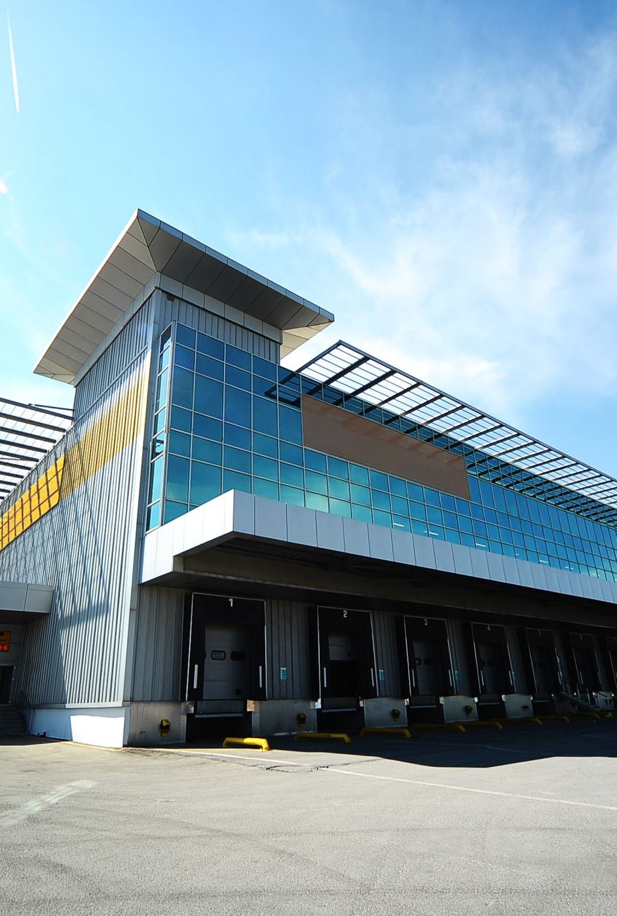
Case Discussion #1
Bigger Bookshop? A used book dealer with a small store in downtown Columbia is considering expanding. The shop occupies a small and crowded storefront space at the street level. The book dealer wonders whether he should expand to the second floor by adding a staircase and additional selling space upstairs.
What is the overall management problem?
What are the major decisions this book dealer needs to make?
What information does the book dealer need to make these decisions?
If you were conducting a survey to help this book dealer make these decisions, what research objectives should you have for the survey?
Notes:
Refer to CD1 Dicussion
What do you think the symptoms here?
What do you think the cause of this symptoms?
What are the major decision this book dealer needs to make?
Expand to the second floor or not?
What to add
Coffee bar: internet, Free wifi. atmosphere.
Profitable, cost? Source of money to invest. （not related to marketing research).
Clarify marketing goals:
what‘s the target market: existing customers vs. new customers.
What’s KPI: increase sales, or satisfaction
What info does the book dealer need to make these decisions?
To measure current customer satisfaction with the store size.
To measure current customer satisfaction with the assortment.
What lines to be added to the second floor: coffee shop, internet cafe
Satisfaction with current decoration, atmosphere.
Cost of remodeling (not related to marketing research, X), terms of financing.
RQ: What percent of current customers would like a larger selection at the bookstore?
QQ: The selection of books at this store is....
__ too small __about right __larger than I need
RQ: How likely are customers to use a coffee bar if it was added to the bookstore?
QQ: If an upstairs coffee bar was added to the bookstore, how often would you use it?
__most times I visit the store
__sometimes when I visit the store
__rarely
__never

Slide 28
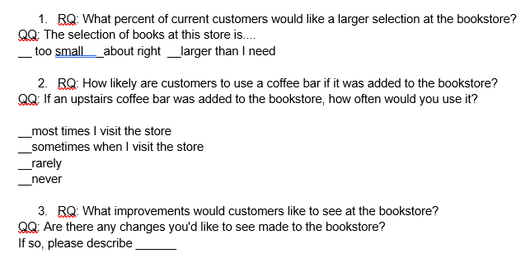
Research Questions vs. Questionnaire Questions

Slide 29

5-min snippet – Spread of Disease
Notes:
Circle Visualization
This model explores the spread of disease in a number of different conditions and environments. In particular, it explores how making assumptions about the interactions of agents can drastically affect the results of the model.
Other models
HIV
Disease Solo
Disease HubNet
Disease Doctors HubNet
epiDEM Basic
epiDEM Travel and Control
Virus on a Network
Communication models:
Communication T-T Example
Communication-T-T Network Example
Language Change
In particular, look at how the different parameters of the model influence the speed at which the disease spreads through the population.
For example, in the “mobile” variant, the population (NUM-PEOPLE) clearly seem to be the main driving force for the speed of infection.
Try 50, 200, 400
Is that the case for the other two variants as well? Some suggestions of parameters to vary are given below under THINGS TO TRY.
Another thing that you may have noticed is that, in the “network” variant, there are cases where the disease will not spread to all people. , here we can see it plateaus .
This happens when the network has more than one components (isolated nodes, or groups of nodes that are not connected with the rest of the network)
and that not all components get infected with the disease right from the start
Similarly, set different values for the CONNECTIONS-PER-NODE slider and run the NETWORK variant. How does the CONNECTIONS-PER-NODE slider affect the results?
Set 1,2, 3 connections.
Now, we can try environnemental variant.
Set different values for the DISEASE-DECAY slider and run the ENVIRONMENTAL variant. How does the DISEASE-DECAY slider affect the results?
Set 3, 5, 8

